Slide 1
Rare-earth nitride films
Growth and Transport Measurements

Slide 2
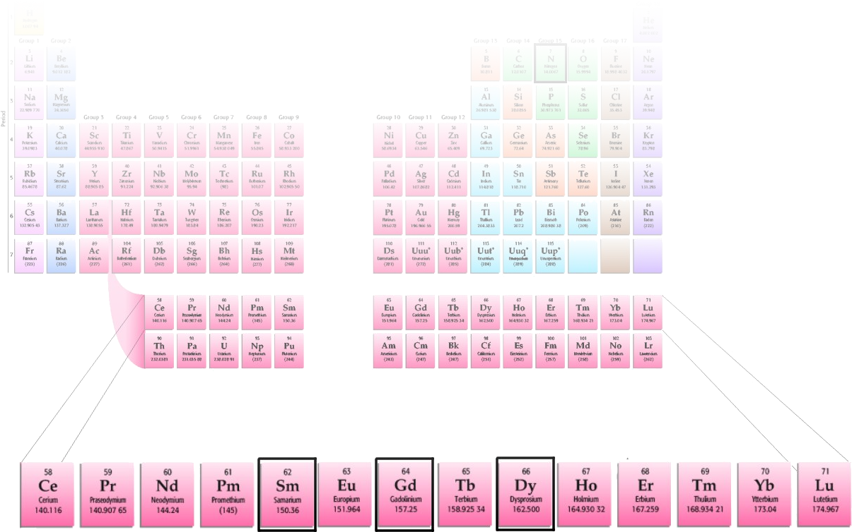
Introduction
Largely ionic: RE³⁺ N³⁻
Rock salt structure
Lattice constants
React with atmosphere (passivate with capping layer)
Oxygen content?
Magnetic ordering and electronic structure
  See talk this afternoon

Slide 3
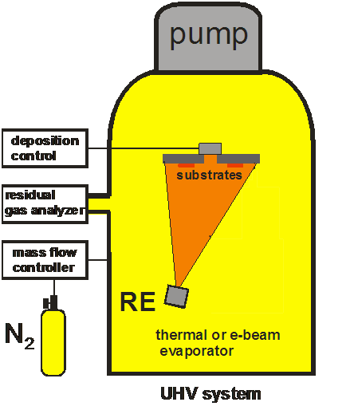
Growth - N₂
UHV
  P_{base} < 10⁻⁸mbar
  O₂, H₂O ~ ppm
  N₂: 5N (scrubbed)
  RE: 3N
Growth
  P_{N2} ~ 10⁻⁴mbar
  Deposit ~ 0.1nm.s⁻¹
Surprising!

Slide 4

Growth - IAD
Kaufman type Ion Gun
  Flux ~ 0.05mA.cm⁻²
  E_{k} ~ 0-1000eV
N⁺:RE ≥ 1:1

Slide 5
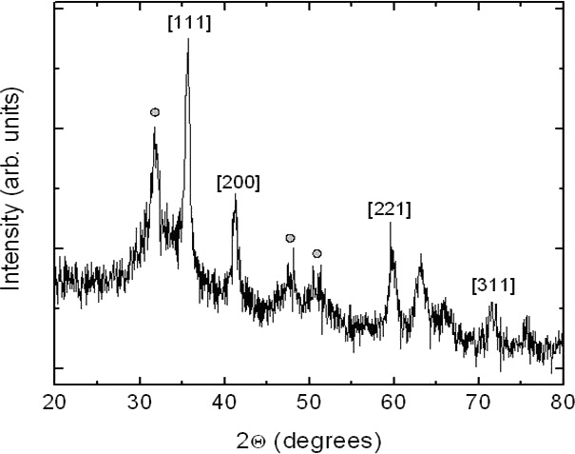
Characterisation
Good 1:1 stoichiometry ± 2% (RBS)
Low O content, uniform films (SIMS)
8nm crystallites (XRD)

Slide 6
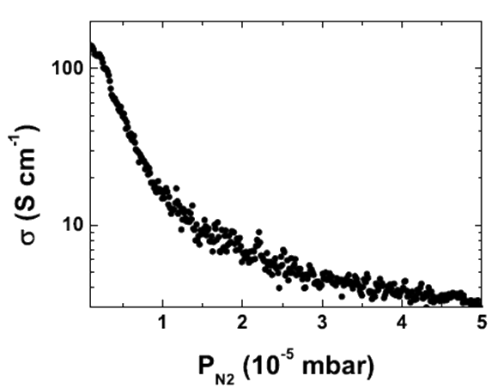
Nitrogen content
N vacancies apparently dope the film.

Slide 7
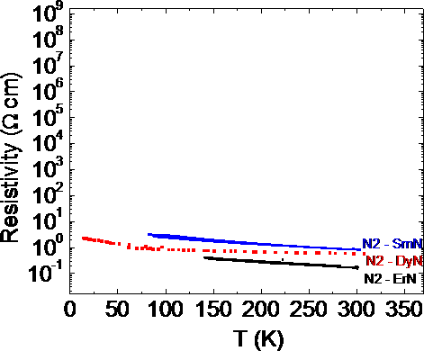
Resistivity
IAD
  lnρ ~ (1/T)1/4
  Variable range Hopping
N₂
  lnρ ~ ¹/_{T}
  Dopants pinned near mobility edge

Slide 8
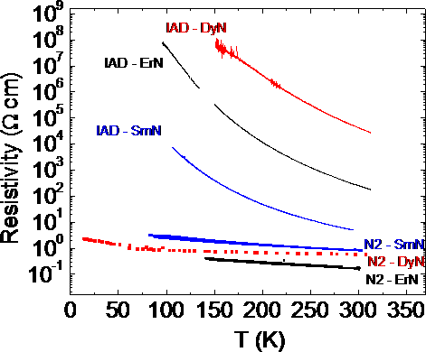
Resistivity
IAD
  lnρ ~ (¹/_{T})^{1/4}
  Variable range Hopping
N₂
  lnρ ~ ¹/_{T}
  Dopants pinned near mobility level
Key point: IAD films have fewer N vacancies

Slide 9
Summary
SmN, ErN and DyN are all semiconducting above 100K
  So is GdN Granville et al, “Semiconducting ground state of GdN thin films”, Phys. Rev. B 73, 235335 (2006)
Conductivity controlled by N vacancies
Activated nitrogen (IAD) brings carrier concentration down
Much more this afternoon: Electronic structure of SmN, DyN and GdN
  D40 (2.30pm), room 503, talk at 5.18pm

Slide 10
Acknowledgements
Ben Ruck, Simon Granville, Felix Budde, Jianping Zhong, Joe Trodahl
  Victoria University of Wellington
  The MacDiarmid Institute
Tony Bittar, Grant Williams
  Industrial Research Ltd.

Slide 11
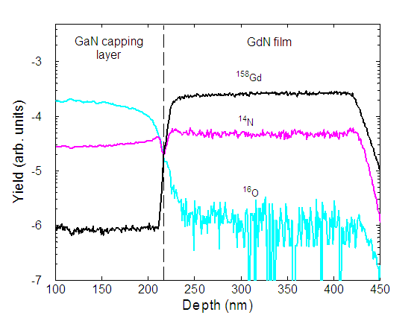
Extra Info – SIMS profile
N₂ GdN (GaN cap)

Slide 12
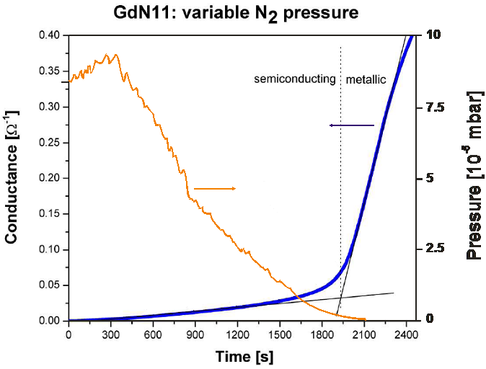
Extra Info – N₂ content

Slide 13
Extra Info – Hall effect
In progress (have preliminary results)
  Need: low carier concentration, high mobility
  Have: high carrier concentration, low mobility!

Slide 14
Extra Info - XRD
Expanded lattice constant

Slide 15
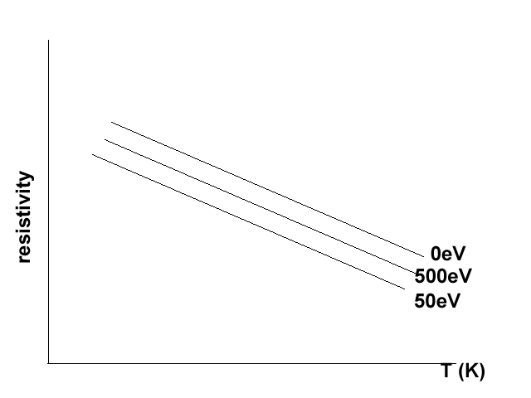
Ion Energy
GdN (0,50,100,500eV)

Slide 16
Extra Info – RBS

Slide 17
Questions
Oxygen content
Magnetic ordering and electronic structure
  See talk this afternoon

